Slide 1
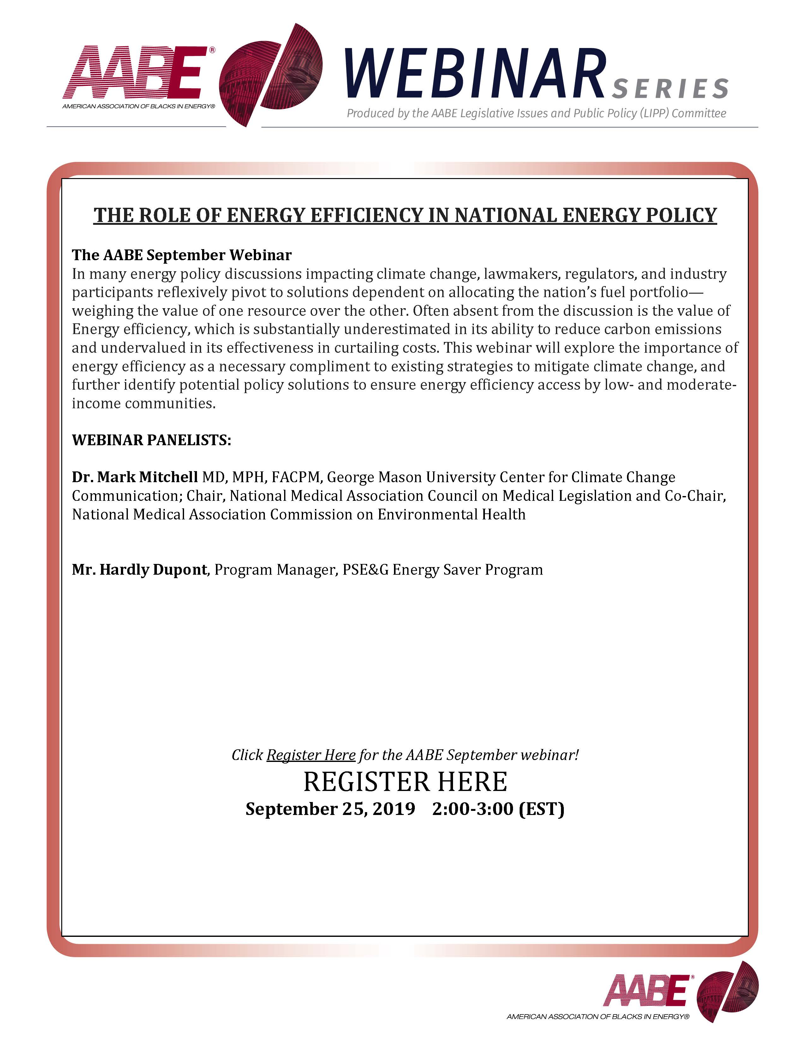

Slide 2
September Webinar Panelists: Dr. Mark Mitchell MD, MPH, FACPM Mr. Hardley Dupont, PSE&G

Slide 3
The Role of Energy Efficiency in a National Energy Policy
By Mark A. Mitchell, MD MPH FACPM
Associate Professor
Climate Change, Energy, and Environmental Health Equity
George Mason University
American Association of Blacks in Energy Webinar
September 25, 2019

Slide 4
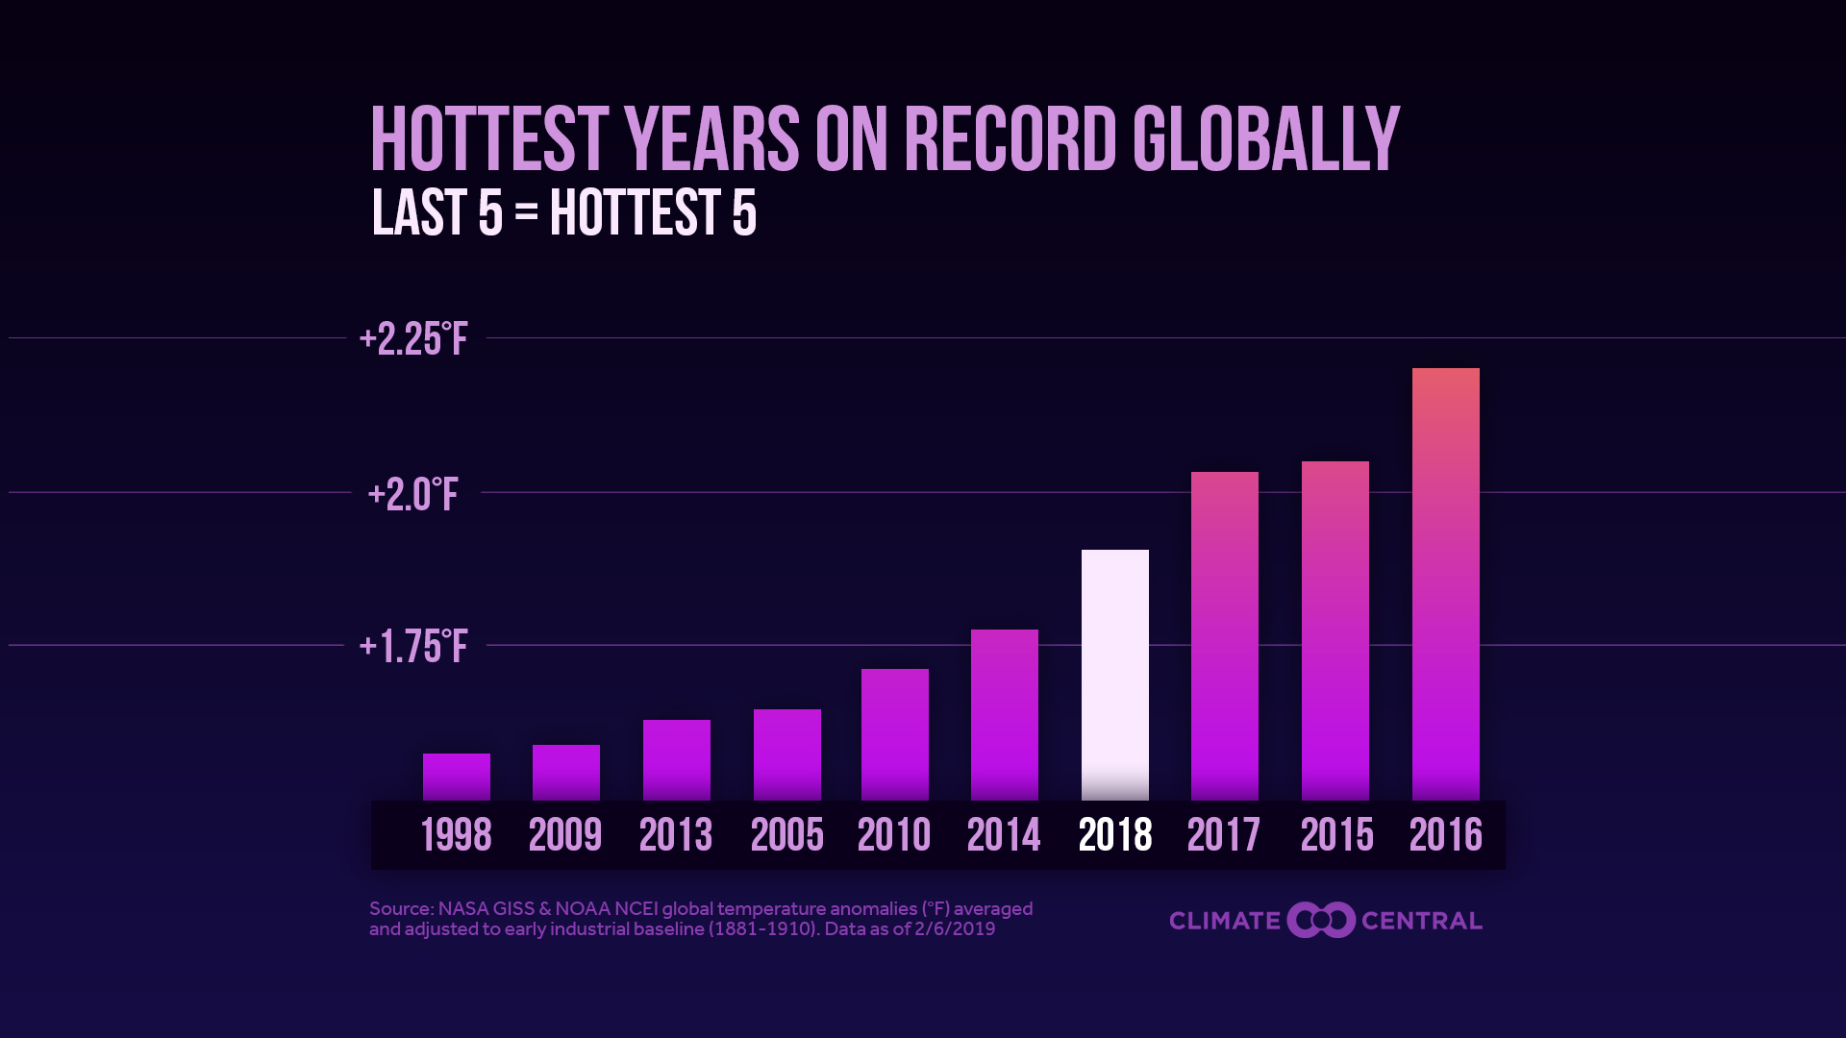

Slide 5
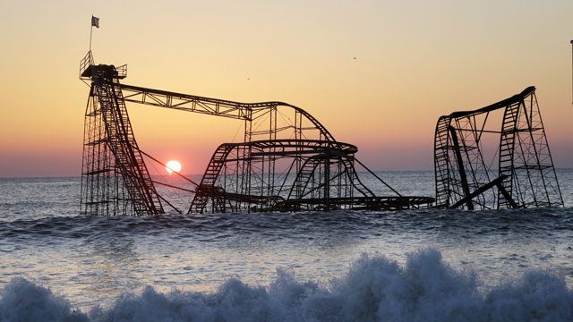
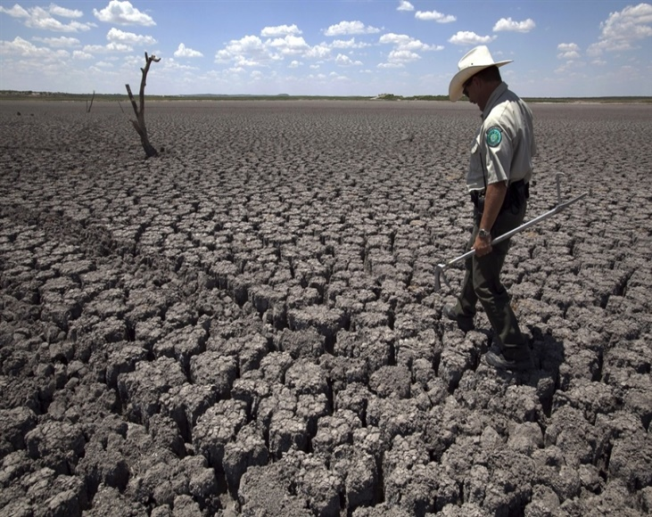
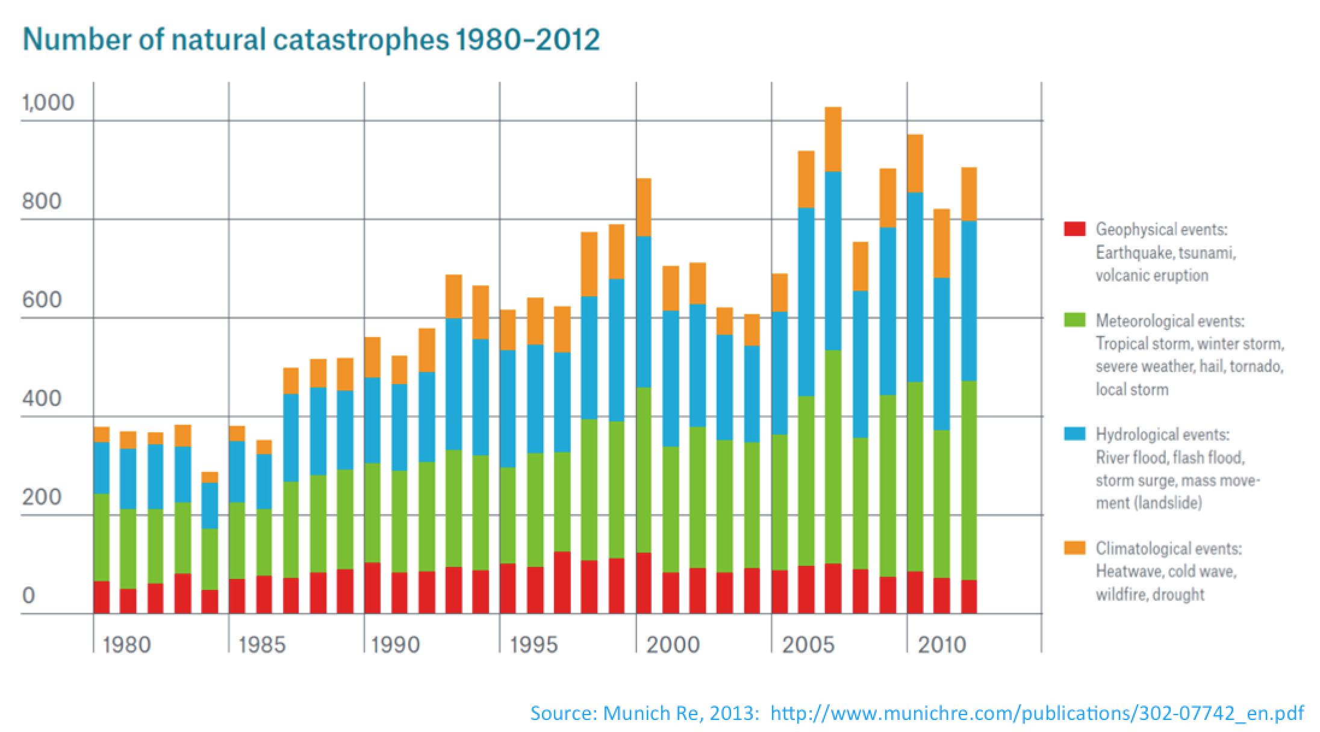
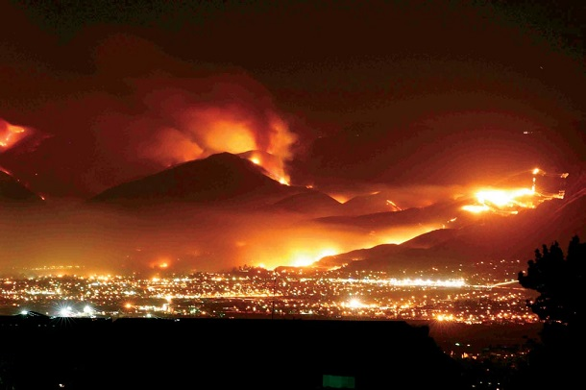

Slide 6
Climate change is harming the health of Americans today
This harm will only increase unless we act!

Slide 7
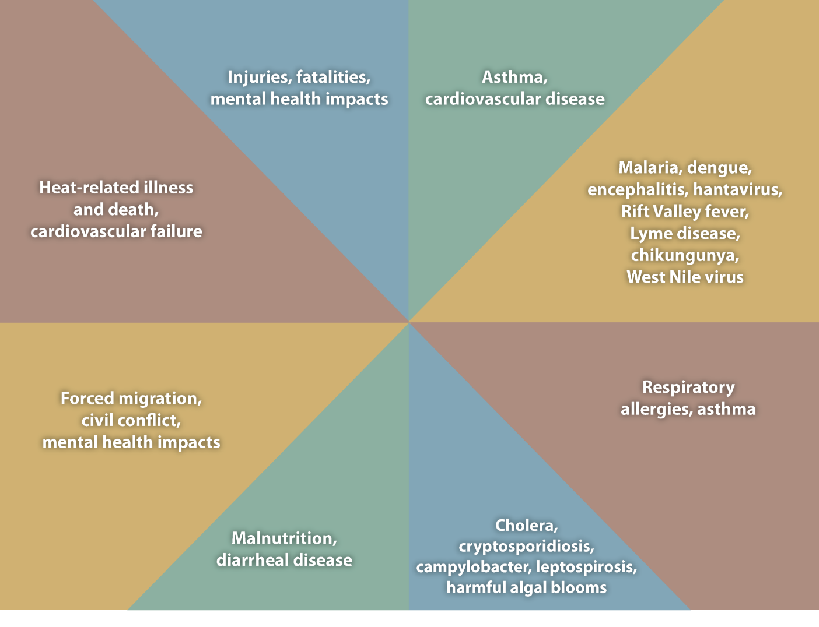
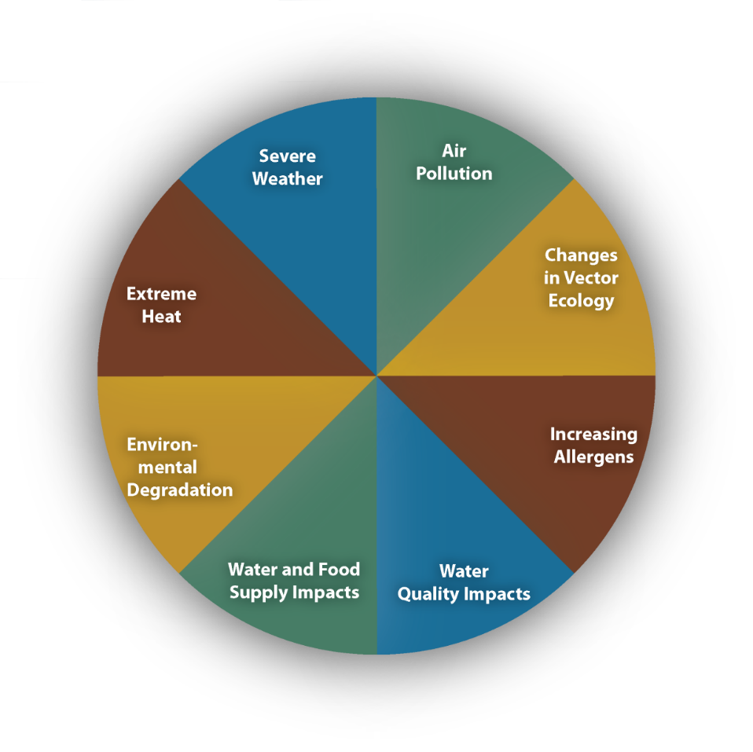
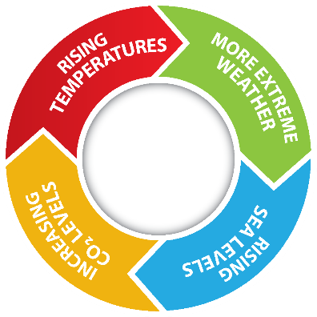

Slide 8
Every one is affected whether they know it or not,
but some are affected more than others!

Slide 9
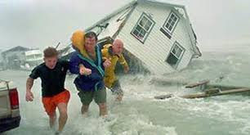
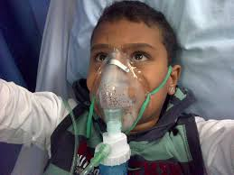
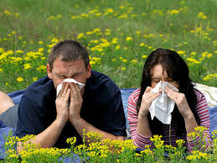
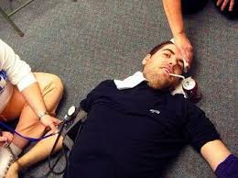
Physicians are Seeing Effects in Their Patients*
 |  |  |  |  | NMA | ATS
 |  |  |  |  | n=283 | n=915
Climate Change is affecting the health of my patients
 | Injuries due to storms, floods, droughts, fires |  |  |  | 88% | 57%
 | Air pollution related increases in severity illness |  |  |  | 88% | 77%
 | Increased care for allergic exposures (plants, mold) |  |  |  | 80% | 58%
 | Heat Effects (heat stroke, heat exhaustion) |  |  |  | 75% | 48%
 | Vectorborne Infx (Lyme, Zika, West Nile, Dengue) |  |  |  | 58% | 40%
* Responded “Yes” to “Are Your Patients Affected”

Slide 10
The way to slow or stop these harms is to decrease the use of fossil fuels and increase energy efficiency and use of clean energy sources.
These changes in energy choices will improve the quality of our air and water and bring immediate health benefits.

Slide 11
What is Energy Efficiency?
Using less energy to accomplish the same tasks (transportation, housing, appliances, etc.)
Reduces GHG
Lowers energy costs
Lowers base load energy demand
Produces immediate savings and health benefits
Is the least expensive source of energy resources

Slide 12
American Council for an Energy-Efficient Economy (ACEEE) Reports:
Conservation is the third largest energy resource
Saves American households $840 per year
Can potentially be the largest energy resource by 2030, saving up to 1000 terawatt-hours of electricity (800 power plants)

Slide 13
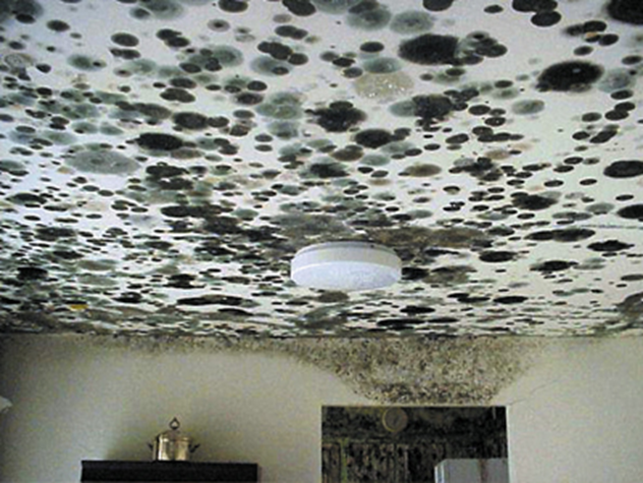
The Story of Luz
Low-income working homeowner
Single mother of three

Slide 14
Low Income Challenges
Energy cost is higher per square foot of housing-less energy efficient ($1.41 vs $1.17)
Energy cost is higher percent of income (energy burden of 7.2% vs 3.5% average, although it varies widely)
People with high energy burdens have more respiratory
disease and stress
Renters often pay energy bills, but don’t/can’t invest in EE

Slide 15
Patchwork of Energy Assistance Programs
Often do not coordinate eligibility or services leading to confusing policies and gaps in service
Federal
LIHEAP-Low Income Energy Assistance Program
WAP-Weatherization Assistance Program
State Utility Regulatory Controlled Programs
Electricity
Gas
Water
Private Grants and Donations
Reimbursement vs Direct Service Provision
Up Front Charges and Credit Requirements
Many Types of Targeted Buildings (e.g. Development Zone Commercial Buildings)

Slide 16
Benefits of Energy Efficiency Programs
Save money to households/communities
Improve health and safety
Reduce risk of utility rate increases
Reduce costs of shut-offs and arrearages
Invest in local economy
Create local entry level jobs

Slide 17
Policies Need to be Expanded and Designed to Meet Diverse Needs
Coordinated programs
One-stop shopping
Fund local organizations to assist residents across programs
Low income savings goals and program spending requirements

Slide 18
Resources
State programs in New York, Massachusetts, Rhode Island
People United for Sustainable Housing (PUSH-Green) Buffalo, NY
Closing the Gap in Energy Efficiency Programs for Affordable Multifamily Housing – A Research Report from American Council for an Energy-Efficient Economy, April 9, 2019 https://aceee.org/research-report/u1903
Lifting the High Energy Burden in America’s Largest Cities- A Research Report from American Council for an Energy-Efficient Economy, April 20, 2016 https://aceee.org/research-report/u1602

Slide 19
Thank You
Mark A. Mitchell, MD MPH
Associate Professor, Climate Change, Energy and Environmental Health Equity
George Mason University
mmitch3@gmu.edu

Slide 20
Support for Vulnerable Utility Customers
Hardley Dupont
Program Support Manager
Energy Efficiency

Slide 21
PSE&G Focus on Vulnerable Customers
PSE&G has a long history of supporting vulnerable customers in New Jersey, and connecting customers with energy services
Local presence in communities through customer service centers
Partnerships with community organizations and social service agencies
Energy Efficiency Programs that focus on vulnerable customer populations
Comfort Partners Low Income – free energy efficiency upgrades and safety checks
Multifamily – assistance to building owners to provide energy efficiency upgrades, reducing energy cost and increasing tenant comfort
Low Income Multifamily Smart Thermostat Pilot – installation of smart thermostats in lower income multifamily buildings to better understand this customer segment
Programs that support low income communities:
Direct Install – covers 70% of the cost for energy efficiency upgrades for businesses in urban enterprise zones, non-profits and government facilities
PSE&G plans to further enhance focus on low income customers with CEF-EE:
Home energy reports to low income customers
Smart thermostat rebate promotions to low income customers
There is so much more that can be done. PSE&G’s Clean Energy Future proposal proposes expansion of programs and leverage our customer and community relationships.

Slide 22
What is Energy Efficiency?
Using less energy to accomplish the same tasks (transportation, housing, appliances, etc.)
Reduces GHG
Lowers energy costs
Lowers base load energy demand
Produces immediate savings and health benefits
Is the least expensive source of energy resources

Slide 23
Comfort Partners Program Overview
Comfort Partners is an income qualified program for families at or below 250%* of the Federal Poverty level
Provides installation of free energy efficiency upgrades and safety checks
Automatic qualifiers:
Universal Services Fund (USF)
Federal Supplemental Security Income (SSI)
Home Energy Assistance Program (HEAP)
Temporary Assistance to Needy Families (TANF)
Lifeline
Section 8 Housing
Pharmaceutical Assistance to the Aged and Disabled
Homeowners and renters eligible.
Customers must reside in a 1-14 family residential dwelling and be the customer of record with a separately metered electric or gas account.
PSE&G Proposes to expand these opportunities under its Clean Energy Future – Energy Efficiency proposal.
*Program recently adjusted income eligibility threshold from 225% to 250% of Federal Poverty Guideline.

Slide 24
PSE&G’s Multifamily Housing Efficiency Program – 50% low income and senior housing
$104 million initiative that provides a turn key approach for the customer to consider energy efficiency investments
$74 million initiative that provides a turn key approach for the customer to consider energy efficiency investments
Upon completion, owner re-pays only a portion of the project cost over 60 months interest free on their PSE&G bill
Energy Audit identifies potential energy efficiency measures (EEMs).
Energy efficiency work also greatly improves the comfort, safety and convenience of tenants.
PSE&G pays 100% of the costs to install the identified EEMs upfront
Engineering design based on customer-selected EEMs. Bid-ready project delivered to the MFH owner.

Slide 25
Direct Install Overview & Program Benefits
PSE&G provides a free on-site energy audit, recommend energy efficiency upgrades and provide a detailed cost estimate. PSE&G pays for 100% of the upfront costs and the work is done by a PSE&G authorized contractor. When the work is complete, customers repay only 30% of the total, interest free, over 36 months on their PSE&G bill.*
$98.3 million invested / over 2,000 projects completed since 2009
$21.9 million invested across 680 projects in the small business in UEZs segment
Annual electric and gas energy savings equivalent to taking 12,000 cars off the road for a year
Targets underserved small business customers in Urban Enterprise Zones, as well as nonprofits and governmental facilities
Demand for the program exceeds currently approved program funding
Provides option to repay through the PSE&G bill in a seamless process – no upfront capital from the customer
PSE&G’s program funds 185 jobs – PSE&G’s program represents a significant portion of our vendors’ NJ workload
* Customers may also elect to pay in one lump sum payment

Slide 26
Low Income Multi-Family Smart Thermostat Pilot - Objectives
“Assess the market potential for savings from a programmatic approach to smart thermostat installation in lower income multifamily housing”
400% FPL (Federal Poverty Level) with individual PES&G accounts
Determine challenges, lessons learned and impact:
Market characterization, recruitment & qualification
Technical compatibility
Resident & building operator experience
Energy savings

Slide 27
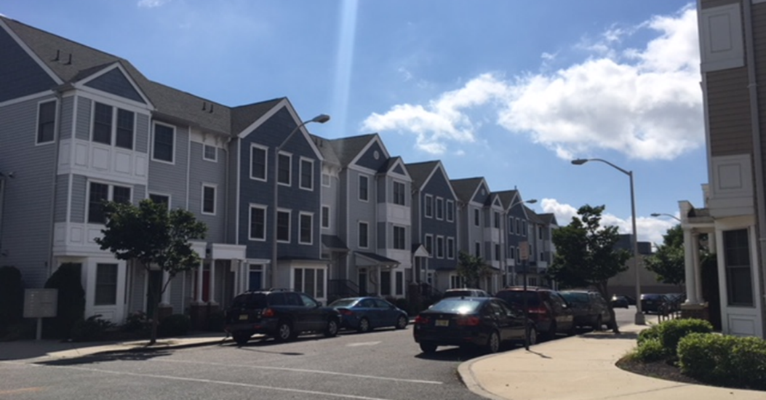
Low Income Multi-Family Smart Thermostat Pilot - Overview
942 thermostats installed in 16 Multifamily properties
All thermostats installed between September and October of 2018
10 properties (490 units) Nest E thermostats with a mixture of tenant Wi-Fi and building level Wi-Fi
3 properties (226 Units) Ecobee 3 with tenant Wi-Fi if present
3 property (226 Units) Honeywell Lyric T6 Z- Wave with building level Mesh

Slide 28
Support for Vulnerable Customers – Proposed CEF Programs Overview

Slide 29
CEF: Energy Efficiency Programs
Investment $2.5B
Universal access to lower customer bills through a comprehensive suite of EE programs
EE Subprograms
Residential Programs $600M | Commercial and Industrial Programs $1.9B
Efficient Products | Prescriptive
Income Eligible | Engineered Solutions
Existing Homes | Small Non-Residential Efficiency
Behavioral | Custom Program
New Construction | Street Lighting
Multi-Family | New Construction
K-12 Education | Energy Management
Pilot Programs (8 pilots)
Other Benefits
Advancement of
NJ clean energy goals
5,000
clean energy
jobs
22
million metric tons of CO₂ removed
3.7
societal cost test score*
*Source: PSEG. Represents the relative value of societal benefits including, among other things, environmental benefits and economic and employment benefits, to program costs.

Slide 30
CEF - EE Residential programs
Program Name | Summary | Total Investment ($M)
Efficient Products | Rebates and on-bill repayment for HVAC, smart thermostats, appliances, lighting, and other equipment | $290
Income Eligible | Energy audit, direct install of efficient equipment, and broader weatherization / appliance replacement services at no charge | $100
Existing Homes | Rebates and on-bill repayment for energy audit, direct install of efficient equipment, and broader weatherization / appliance replacement services | $100
Behavioral | Data analytics, home energy reports and online energy audits | $50
New Construction | Rebates to builders and owners for meeting EE standards | $30
Multi-Family | Energy audit and direct install of efficient equipment at no charge to tenants | $20
K-12 Education | Curriculum to teach EE and a take-home kit with efficient products | $10
Total Residential Program Investment |  | $600M
INCLUDES INFORMATION TECHNOLOGY IINVESTMENTS

Slide 31
CEF - EE C&I and pilot programs
Program Name | Summary | Total Investment ($M)
Prescriptive | Rebates and on-bill repayment for more efficient HVAC, lighting, refrigeration, water heaters, air compressors, and other equipment | $615
Engineered Solutions | Provide hospitals, schools, universities, municipalities, apartment buildings and other non-profit /public entities whole-building engineered energy saving solutions | $350
Small Business | Rebates and on-bill repayment for direct-installed EE measures | $345
Custom | Custom incentives for large EE projects, including on-bill repayment | $245
Pilot Programs (8 subprograms) | Efficiency as a Service, Volt-Var Optimization, Smart Home, Emerging Technologies & Approaches, Building Operator Certification, Business Energy Reports, Non-Wires Alternative, Non-Pipes Alternatives | $160
Street Lighting | Replacement of HPS with LED luminaires and smart cities pilots | $150
New Construction | Rebates to builders and owners for meeting EE standards | $25
Energy Management | Retro-commissioning and Strategic Energy Management: optimizing existing systems with little to no equipment upgrades | $10
Total C&I Program Investment |  | $1,900M
INCLUDES INFORMATION TECHNOLOGY IINVESTMENTS

